Slide 1
Capstone Project
Name : A.SURESH KUMAR
College : Institute of data
Date : 19.10.2024

Slide 2
Project Title / Business Problem :
How can educational institutions leverage predictive analytics to identify at-risk students early in their academic journey, thereby reducing dropout rates and enhancing overall student success.

Slide 3
Data science problem:
Develop models that predict student course outcome at very early stage.

Slide 4
Implementation Considerations:
Data Privacy and Ethics:
When implementing predictive analytics, educational institutions must prioritize data privacy and ethical considerations. Compliance with regulations like FERPA is essential to protect student information while utilizing it for predictive purposes.

Slide 5
Stakeholders:
Administrators:
They need a system that can accurately forecast student performance early in the course, enabling timely interventions and support to prevent dropouts and improve overall success rates.

Slide 6
About Dataset:
This dataset, collected from Portugal, consists of 4,424 student records and 36 features.
It encompasses a range of educational levels, from higher education to undergraduate degrees.
The dataset is publicly available through the UCI Machine Learning Repository.
please visit the UCI Machine Learning Repository at the following link: Predict Students' Dropout and Academic Success - UCI Machine Learning Repository.

Slide 7
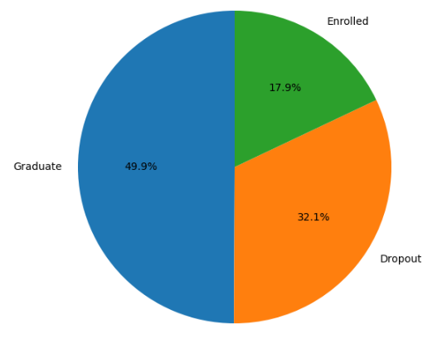
Exploratory Data Analysis: Student enrolment status at the end of the course:
32% of the students
dropout from college.
‘Enrolled’ – refers student
status at the
end of normal duration of the course.
In this project, I’ve considered them as a Graduate .

Slide 8
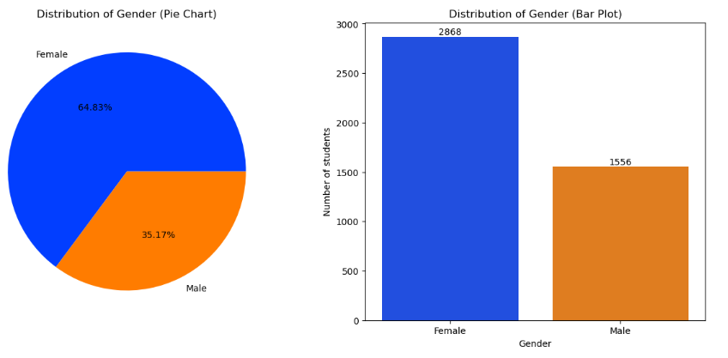
Gender Distribution in Course Enrolment:
Female numbers are much higher than male,
it is a sign of good country.
Women education is very well appreciated.

Slide 9
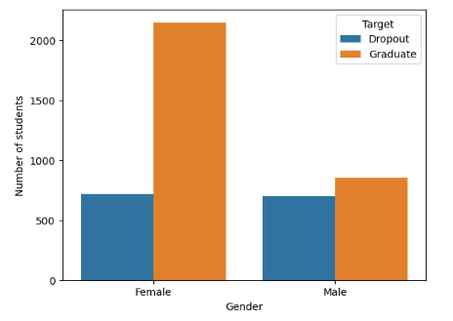
Student status by Gender:
More number of female graduate than male.
Number of male graduate and dropout is very close. This is a worrying sign.

Slide 10
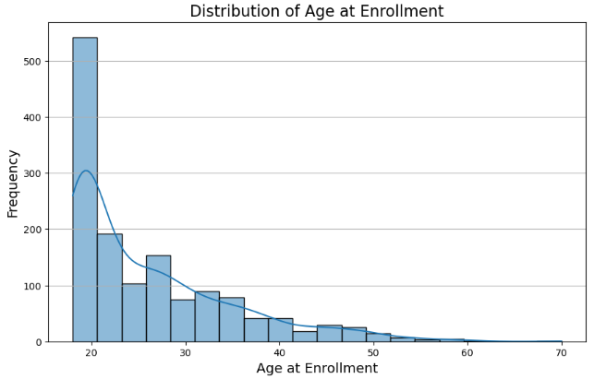
Distribution of Age:
Some people well utilized the evening class option

Slide 11
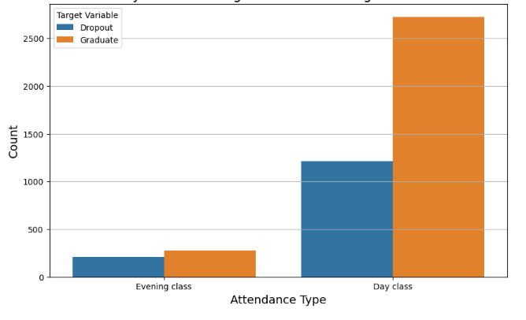
Attendance type:
Evening class dropout is closer to it’s graduate, it needs attention

Slide 12
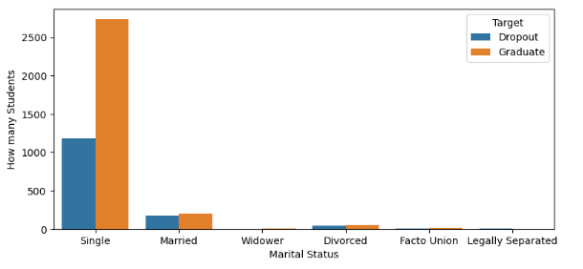

Relationship status:
High number of single students dropping out, not a good sign.

Slide 13
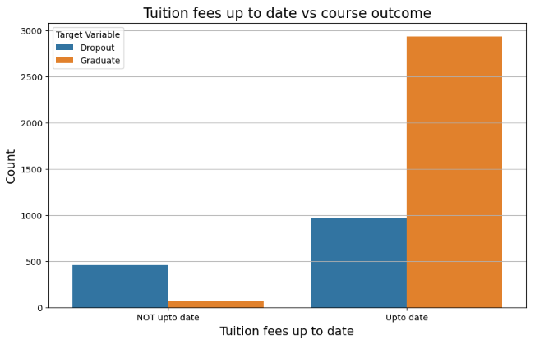
Tuition fees:
Higher tuition fees could be the reason for dropout.

Slide 14
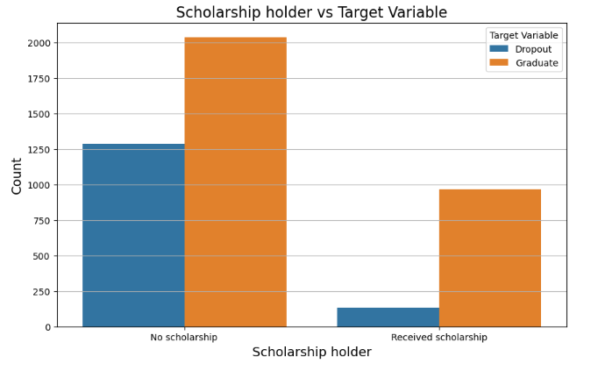
Importance of scholarship:
Student who received scholarship not dropping off that much.

Slide 15
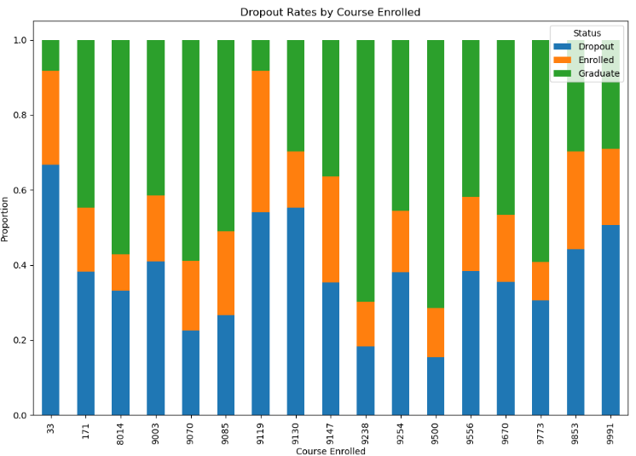
Dropout rates per course:
33: Biofuel Production Technologies
9119: Informatics Engineering
9130: Equinculture
9991: Management ( Eve attendance )
More dropout on those 4 course enrolment

Slide 16
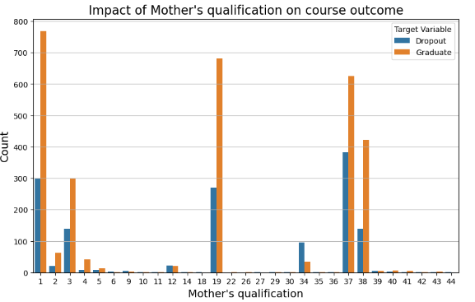
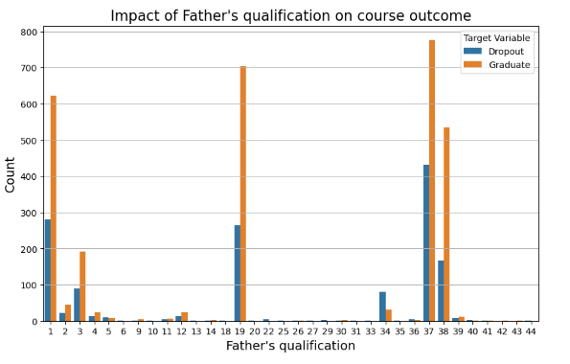
Parent’s qualification:
1: Secondary Education
3 : Higher Education
19 : Basic Education -9th,10th & 11th
37 : Basic Education – 4th,5th
38 : Basic Education – 6th,7th & 8th
Low educated parents knows the importance of Education

Slide 17
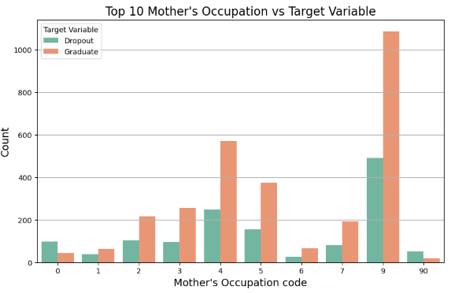
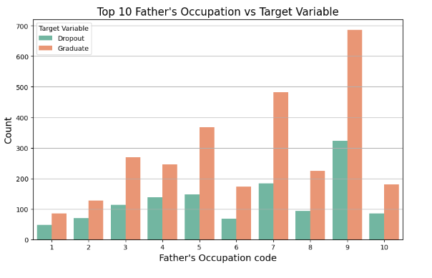
Parent’s occupation:
9: Unskilled
7 : Skilled workers in construction
5 : Security
4 : Admin staff
Low skilled parents / low income is not the reason for dropout

Slide 18
Model’s selection:
It is a binary classification problem.
I have analysed available binary classification models
and compared the results here.
Data selection:
X = All features except ‘Target’
Y = ‘Target’
Model’s taken for considerations:
SVM
Random_forest
Logistic_regression
Naïve_bayes_gaussian
Decision_tree

Slide 19
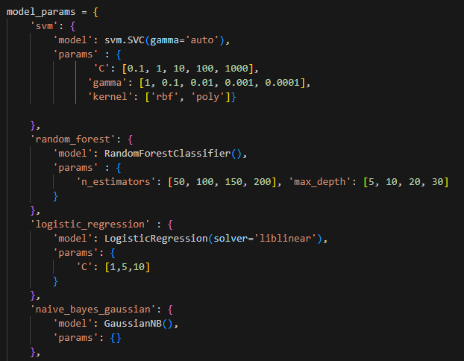
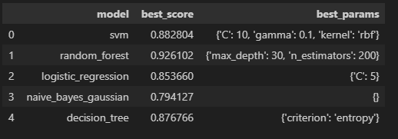
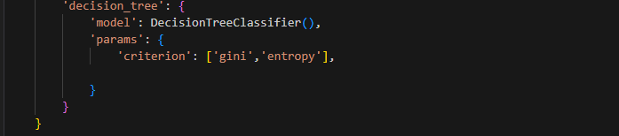

Slide 20
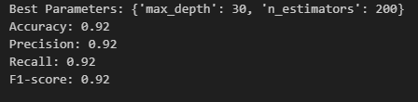
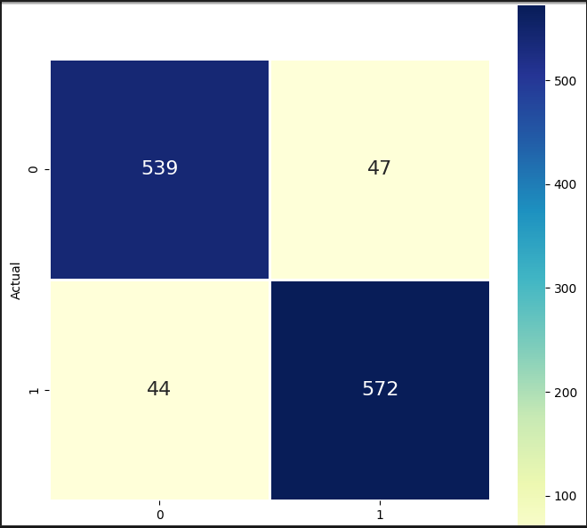
Max_depth : 30, means Trees are allowed to grow 30 levels deep the maximum.
N_estimators : 200, means number of decision trees in the Random Forest.
This model is not only good at making correct predictions overall but also does well in both minimizing false positives (precision) and false negatives (recall).
The model maintains high precision and recall, which means it's good at both identifying positive instances and minimizing false alarms.

Slide 21
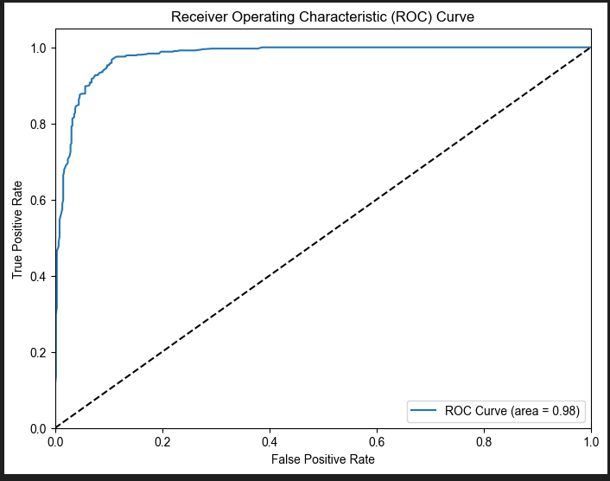
With an AUC of 0.98, this classifier is performing exceptionally well. It suggests that cross various decision thresholds, the model consistently achieves a high True Positive Rate while maintaining a low False Positive Rate.
This means the model is not just accurate at a specific threshold, but performs well at a broad range of thresholds, making it robust for different decision-making scenarios.

Slide 22
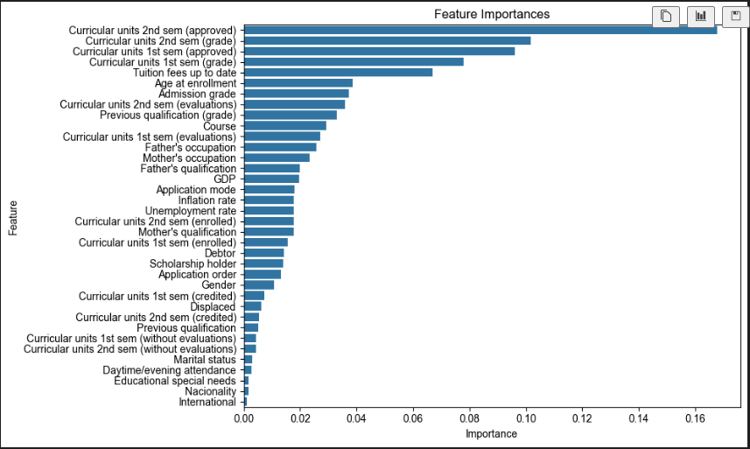
Random classifier’s important features list in order:

Slide 23
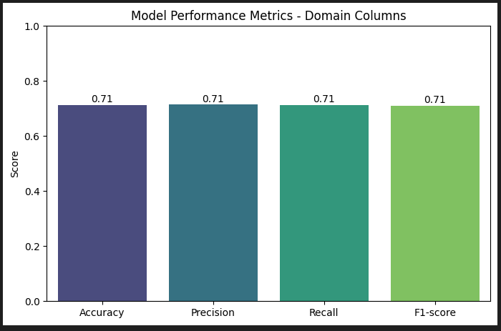
Random Forest Model 1 with EDA experience
Data selection:
X = ‘Scholarship holder’, ’Tuition fees up to date’, ’Age at enrollment’, ’Course’
Y = ‘Target’

Slide 24
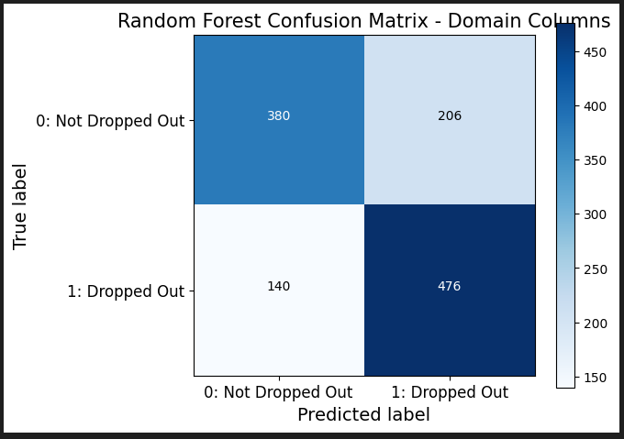
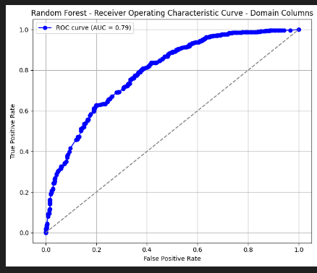
Random Forest Model 1 with EDA experience

Slide 25
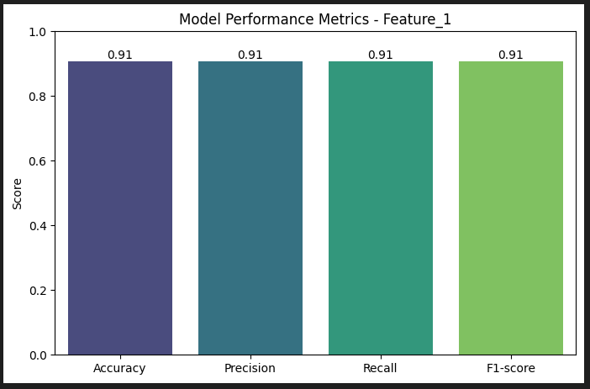
Random Forest Model 2 with Important Features:
Data selection:
X = 'Course', 'Previous qualification (grade)', 'Admission grade', 'Age at enrollment',
'Curricular units 1st sem (grade)','Curricular units 2nd sem (evaluations)',
'Curricular units 2nd sem (approved)','Curricular units 2nd sem (grade)'
Y = ‘Target’

Slide 26
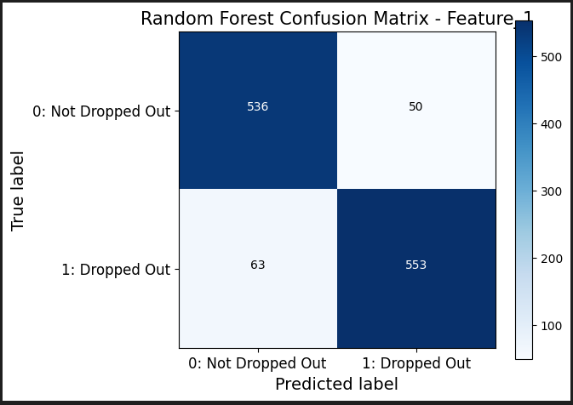
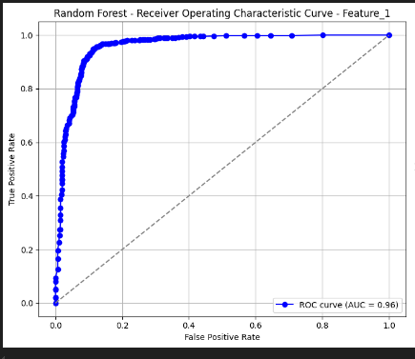
Random Forest Model 2 with Important Features:

Slide 27

I found a good model with better accuracy. But, does that address the business problem?
Does that help our stakeholders to predict the student outcome before signup ?

Slide 28
Random Forest Model 3 with Important Features:
Data selection:
X= ['Admission grade', 'Age at enrollment', 'Previous qualification (grade)’,
'Tuition fees up to date','Course','GDP','Mothers_Occupation’,
'Fathers_Occupuation','Mothers_Qualifications’,
'Fathers_Qualifications']
Y = ‘Target’

Slide 29
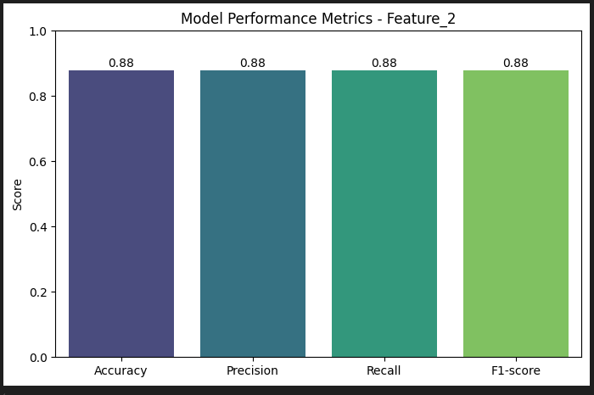
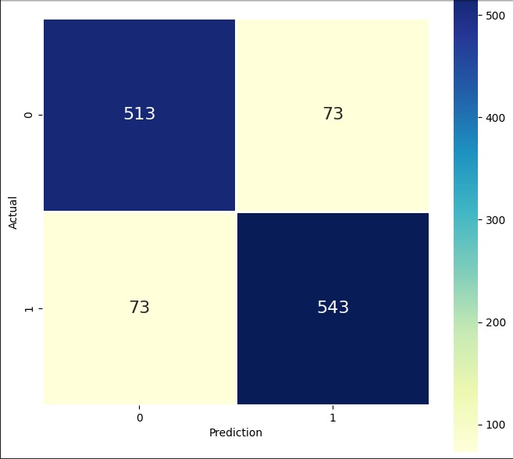
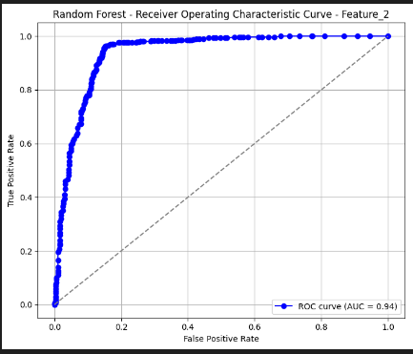

Slide 30
References:
https://archive.ics.uci.edu/dataset/697/predict+students+dropout+and+academic+success
https://github.com/sqlsuresh2005/Cap-project-1
http://localhost:8501/

Slide 31



